Slide 1
MySQL installation and practice & run a Javeweb demo in Eclipse
Yihuai Liang, Yan Li,

Slide 2
Contents
Download and install MySQL
MySQL installer
MySQL Server
MySQL Workbench
Connect DB server through Workbench
Manage DB through Workbench

Slide 3
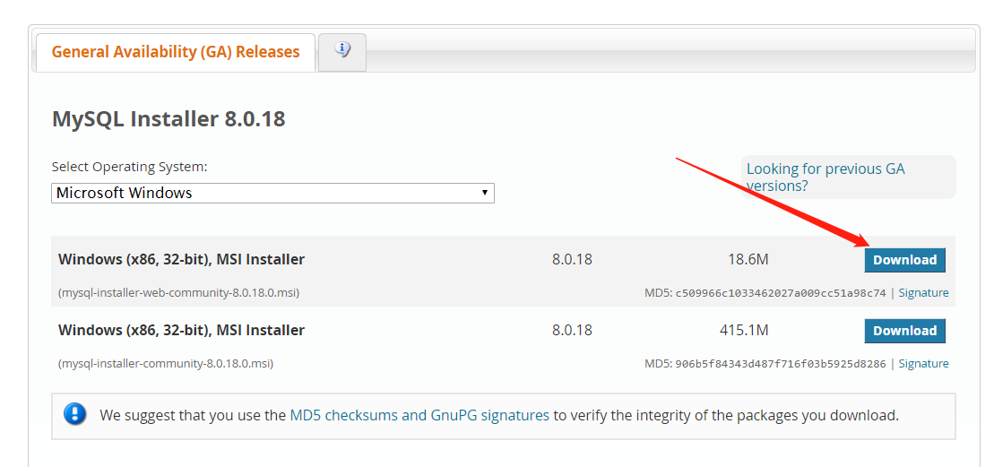
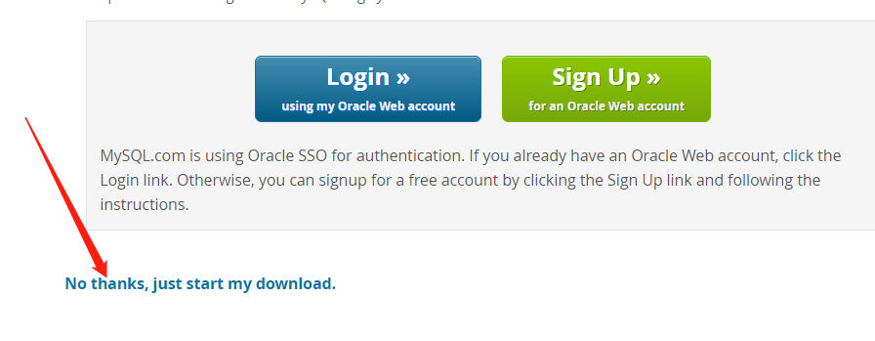
Download MySQL installer
MySQL installer Address:
https://dev.mysql.com/downloads/installer/
Others: https://dev.mysql.com/downloads/

Slide 4
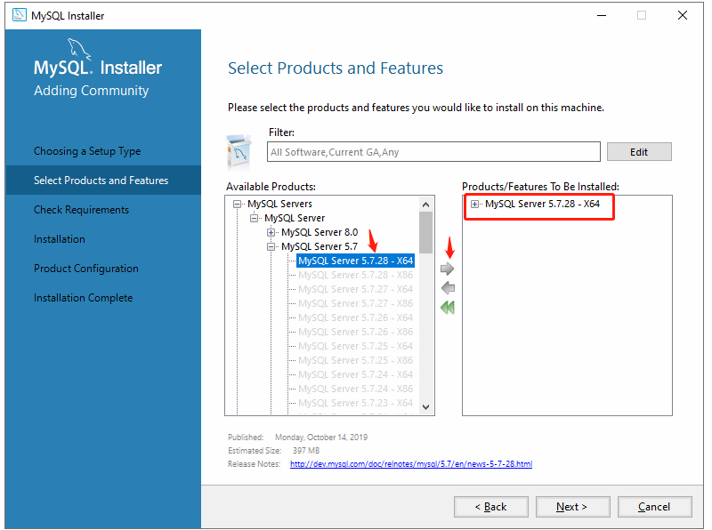
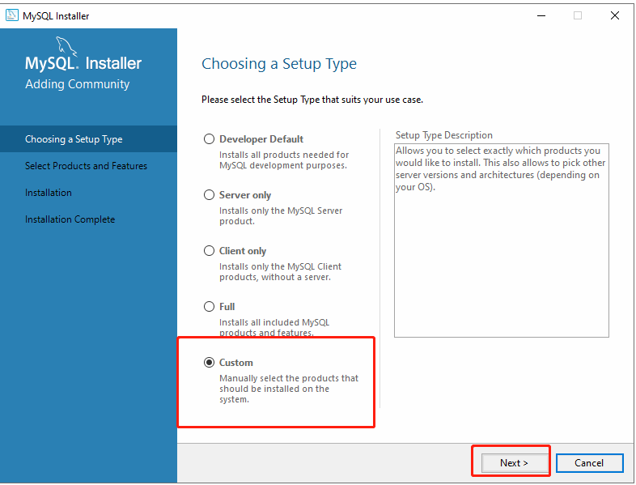
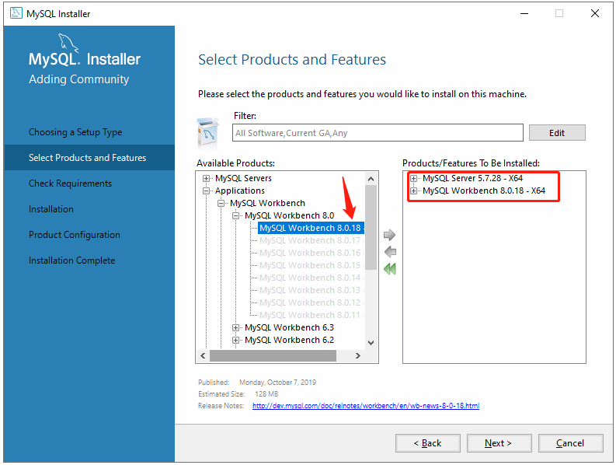
Only MySQL Server and MySQL Workbench

Slide 5
Error (Optional)
Error message：one more product requirements have not been satisified …
Reason: your computer does not have some plug-in.
Solution: select No button of the prompt, then click Execute button, rather than Next button.
After solving the error, click Next button keeping the default setting.

Slide 6
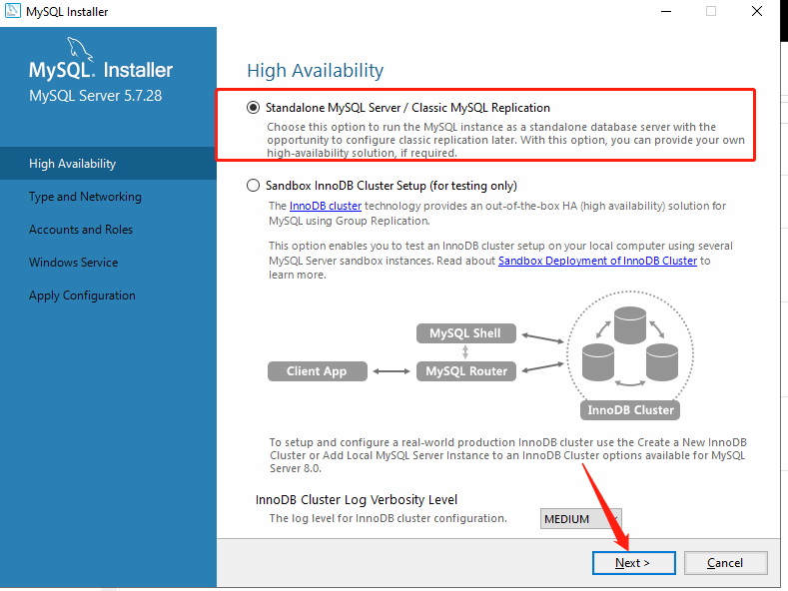
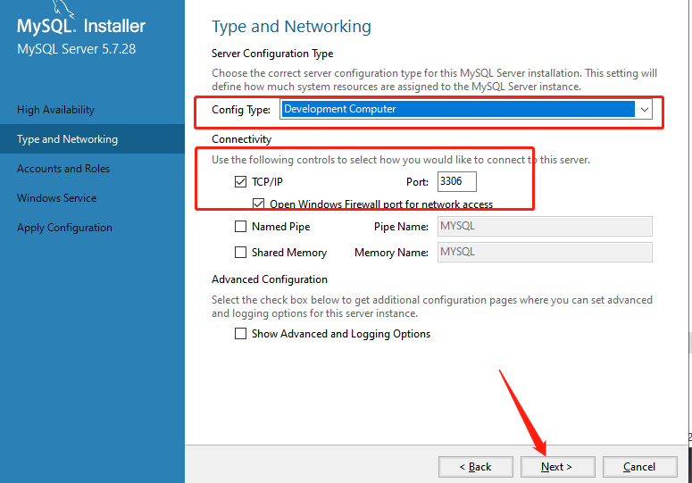
Keep the default setting

Slide 7
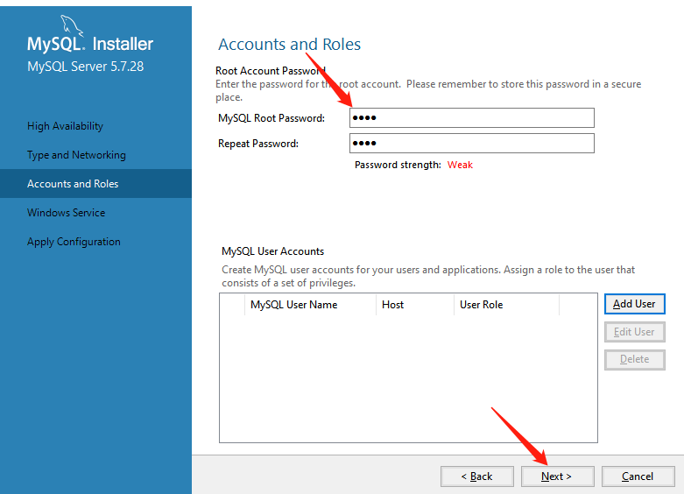
Give a password
For the class practice, a simple password is okay.

Slide 8
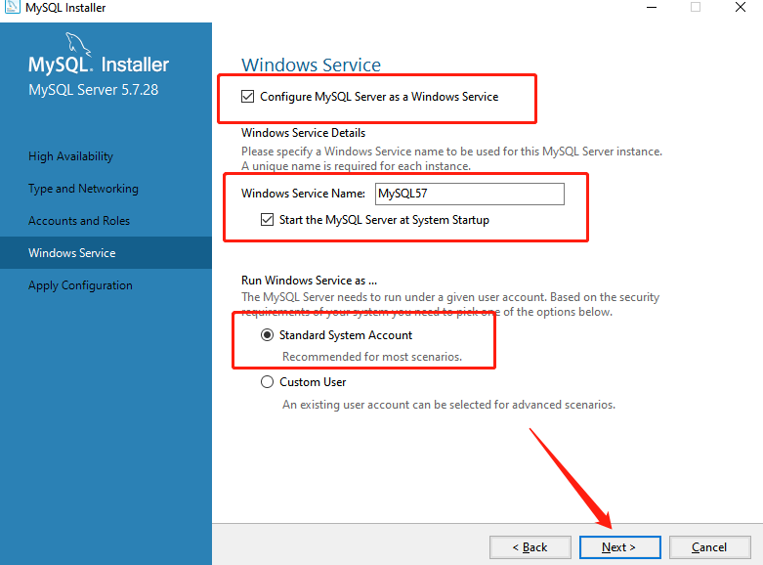
Keep the default setting

Slide 9
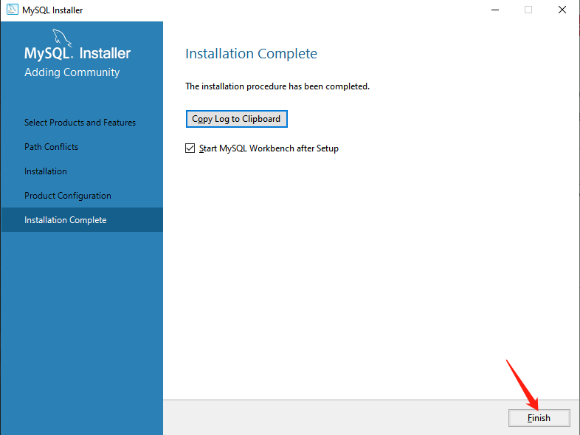
MySQL Workbench starts after clicking Finish

Slide 10
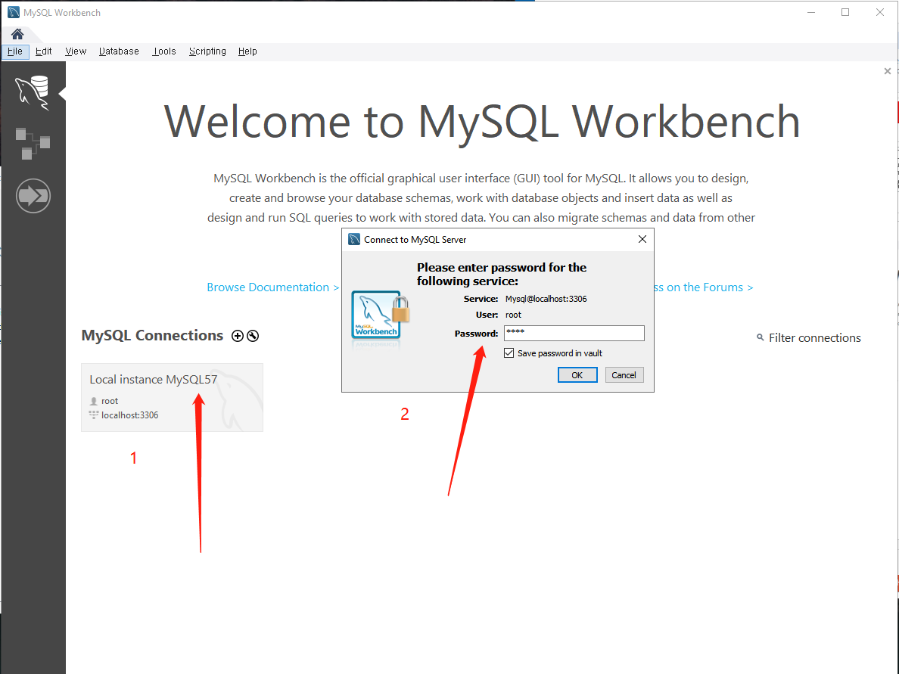
Connect MySQL server
If you can connect to the MySQL server, it means your success in the installation.
MySQL Workbench is a unified visual tool for database architects, developers, and DBAs. MySQL Workbench provides data modeling, SQL development, and comprehensive administration tools for server configuration, user administration, backup, and much more. MySQL Workbench is available on Windows, Linux and Mac OS X.

Slide 11
Play MySQL Workbench (Optional)

Slide 12
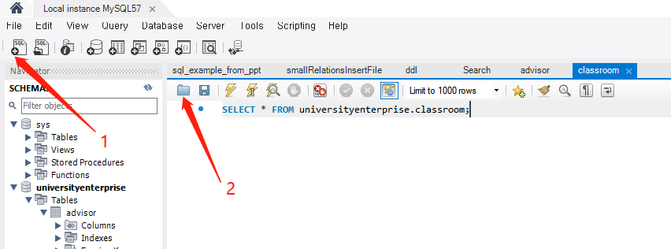
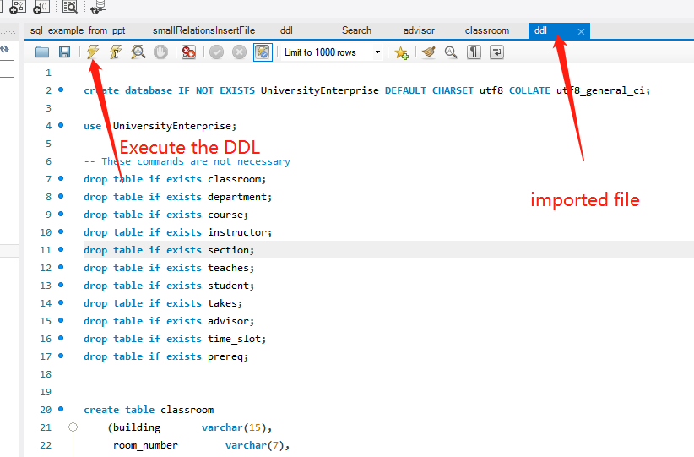
Import SQL DDL
DDL file is available here: https://github.com/liangyihuai/sql-sample-data. The file name is ddl.sql

Slide 13
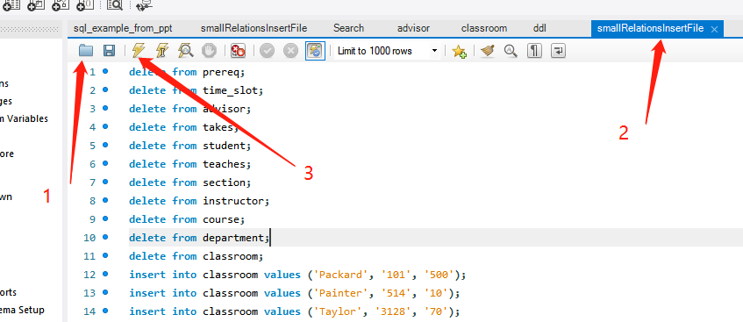
Import sample data
Sample data file is available here: https://github.com/liangyihuai/sql-sample-data.
The file name is smallRelationsInsertFile.sql

Slide 14
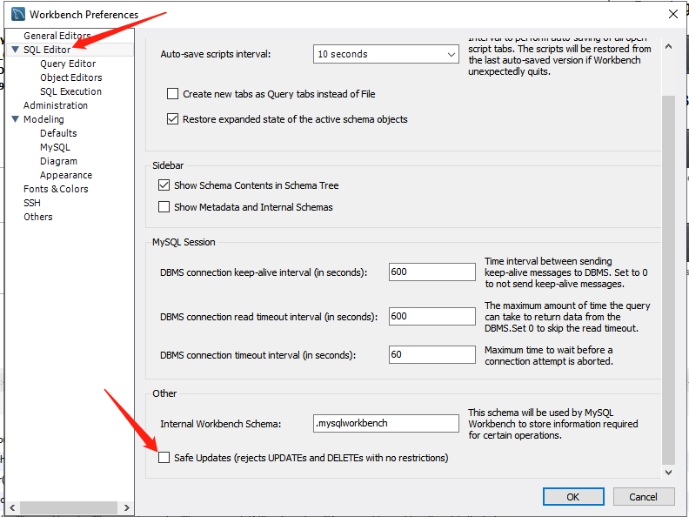
Error while import sample data
Solution:
step1:uncheck “Safe Updates(rejects UPDATEs and DELETEs with no restrictions)”
Step2: restart workbench

Slide 15
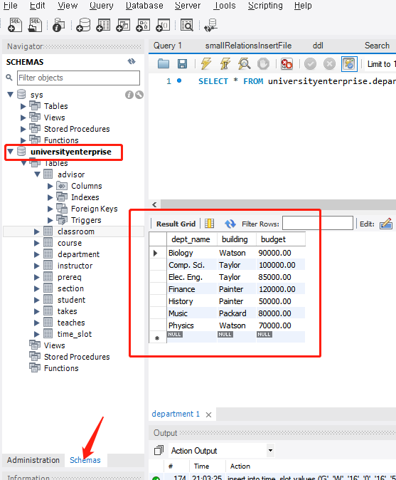
Show imported data

Slide 16
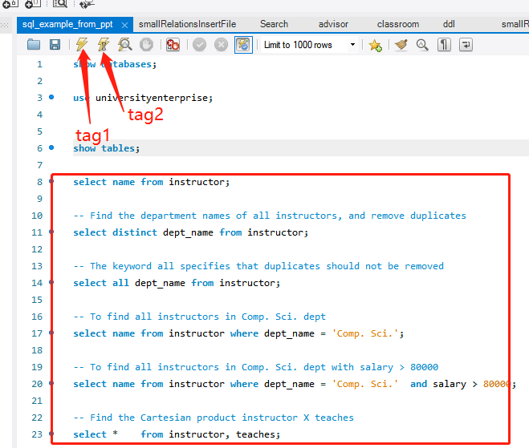
Perform SQL query
tag1: execute all SQLs.
tag2: execute only one SQL in where the mouse cursor put.
show databases;
use universityenterprise;show tables;
select name from instructor;
-- show databases;use universityenterprise;show tables;
select name from instructor;
-- Find the department names of all instructors, and remove duplicates
select distinct dept_name from instructor;
-- The keyword all specifies that duplicates should not be removed
select all dept_name from instructor;
-- To find all instructors in Comp. Sci. dept select name
from instructor where dept_name = 'Comp. Sci.';
-- To find all instructors in Comp. Sci. dept with salary > 80000 select name
from instructor where dept_name = 'Comp. Sci.' and salary > 80000;
-- Find the Cartesian product instructor X teaches
select * from instructor, teaches;

Slide 17
MySQL-based Servlet Project -- run a Demo in Eclipse

Slide 18
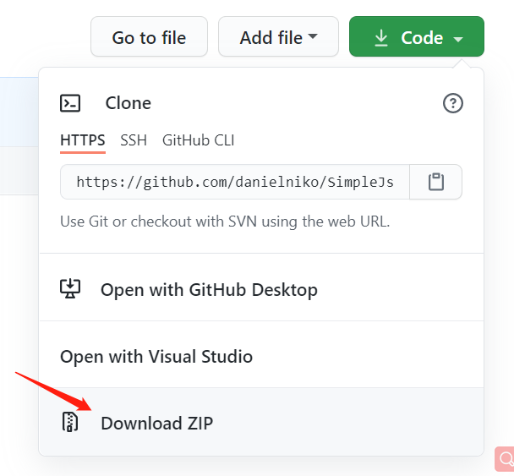
Download source code
https://github.com/liangyihuai/SimpleJspServletDB

Slide 19
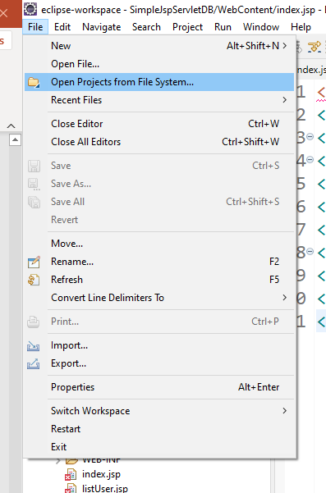
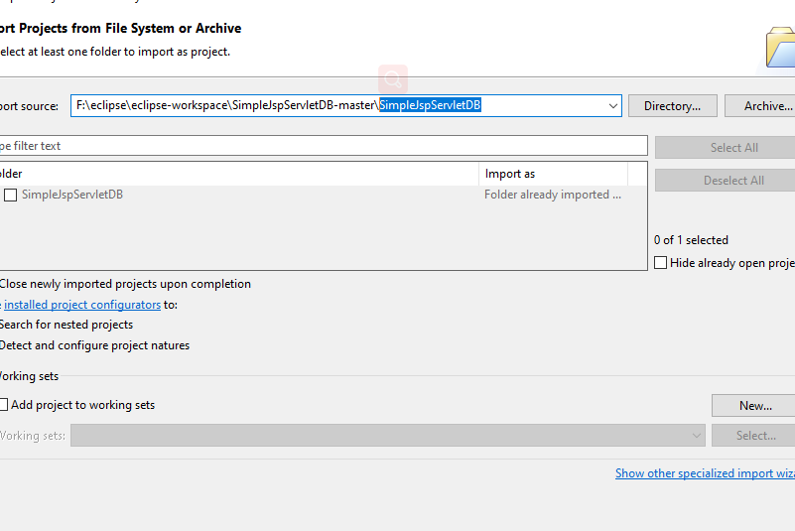
Import the source code into Eclipse

Slide 20
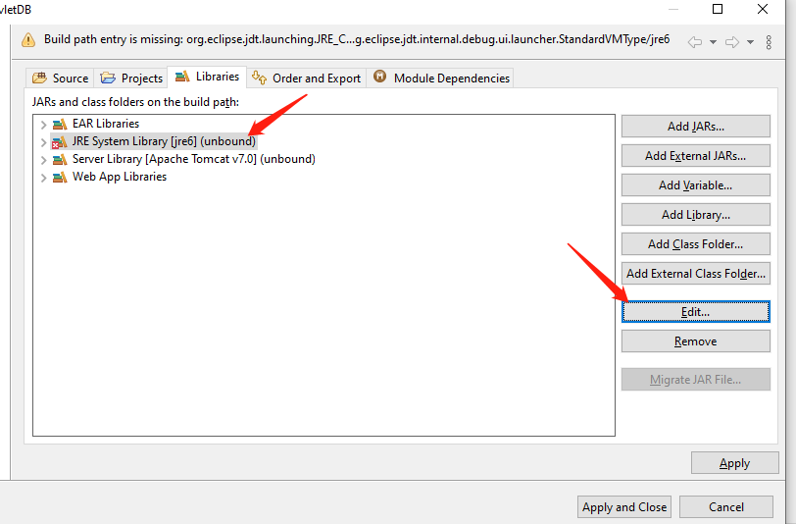
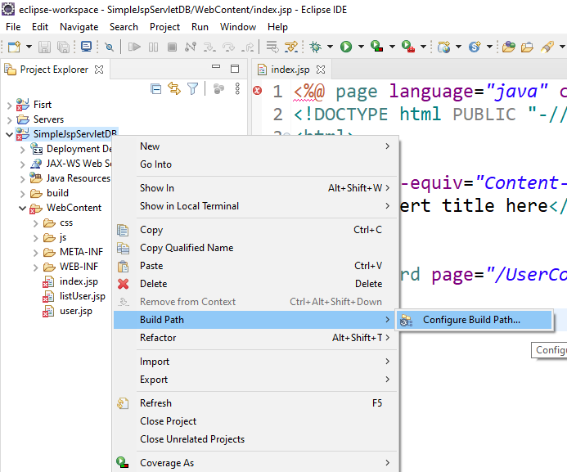
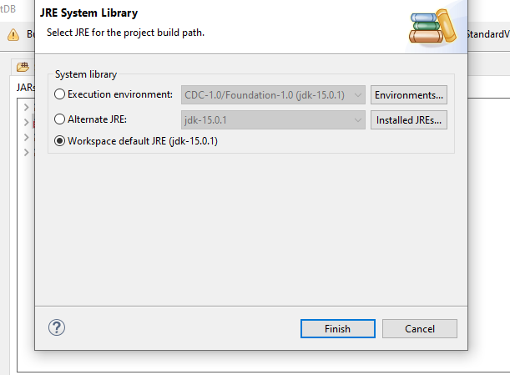
Configure Build Path
Update the setting of JRE

Slide 21
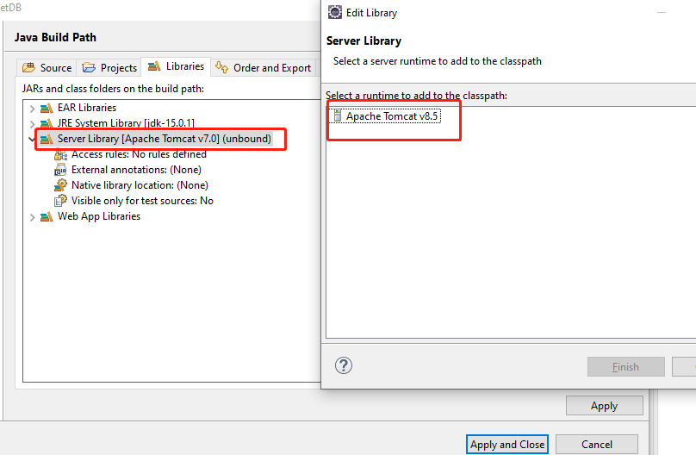
Configure Build Path 2
Same as the previous slide, we update the setting of Apache Tomcat, which has been installed in your computer already.

Slide 22
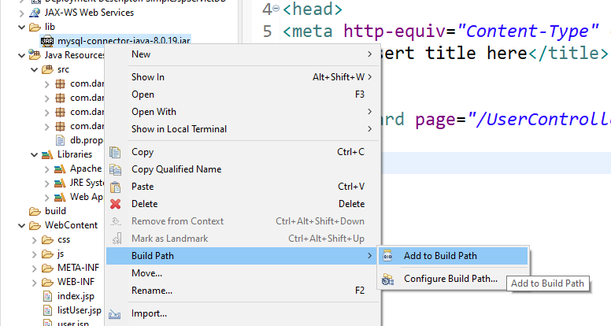
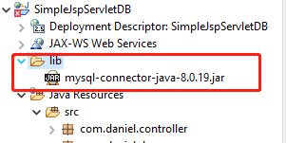
Add JDBC to Build PATH The mysql-connector-java-xx.jar is included in the source code.
Configure Build Path 3

Slide 23
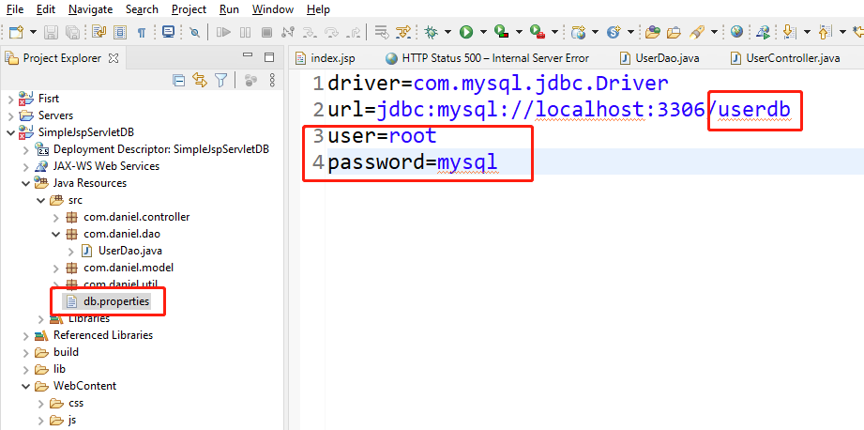
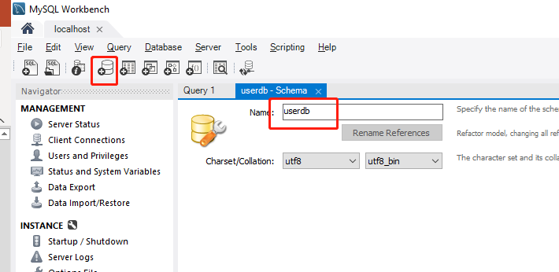
Configure MySQL
This is the database name.
make sure
Create a new database, named userdb, using MySQL Workbench
Your user name and password of the MySQL Server

Slide 24
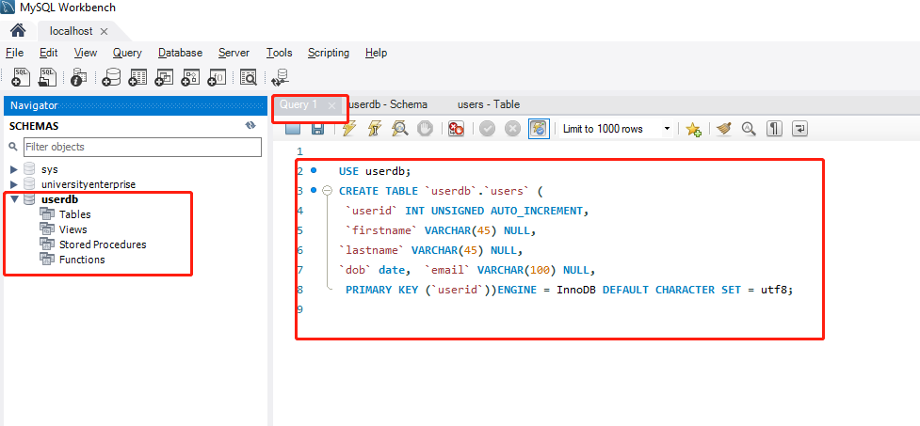
Create a table
USE userdb;
CREATE TABLE `userdb`.`users` (
`userid` INT UNSIGNED AUTO_INCREMENT,
`firstname` VARCHAR(45) NULL,
`lastname` VARCHAR(45) NULL,
`dob` date,
`email` VARCHAR(100) NULL, PRIMARY KEY (`userid`)
)ENGINE = InnoDB DEFAULT CHARACTER SET = utf8;

Slide 25
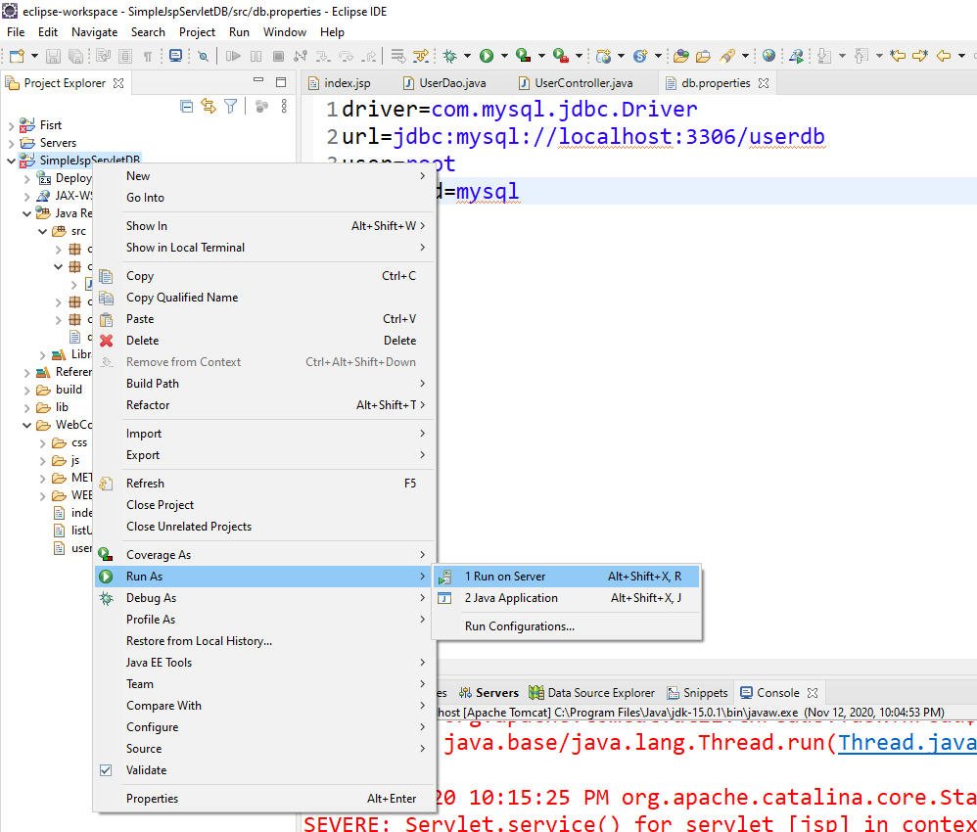
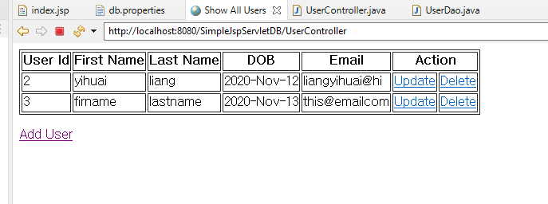
Execute the source code
This is the final result

